Slide 1
Forces in Two Dimensions

Slide 2
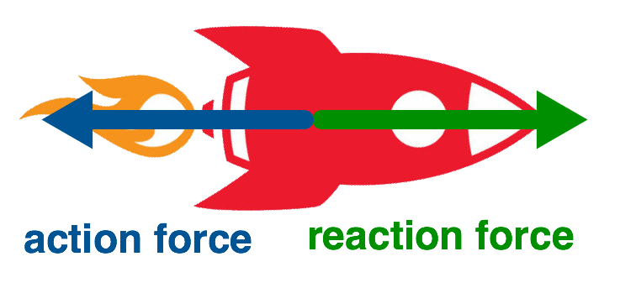
In this Smart Lesson you will learn to:
Identify forces acting on an object.
Construct free-body diagrams representing forces acting on an object.

Slide 3
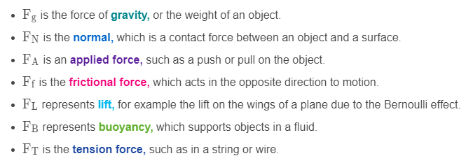
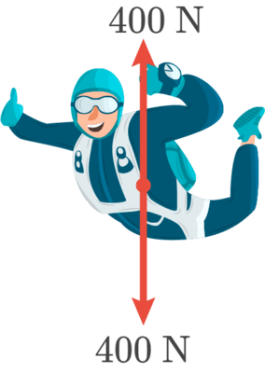
Types of forces.
There are a few common forces that you will come across:

Slide 4
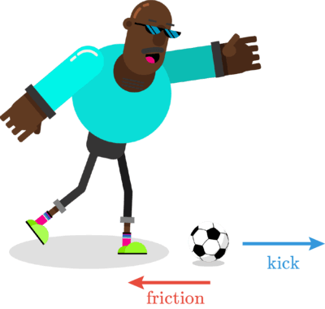
So how do you identify forces acting on an object?
All objects have weight, unless in space away from the gravitational field of any planets or other objects.
If an object is moving, there will always be friction or drag in the opposite direction to the movement, as well as a force in the direction of movement.

Slide 5
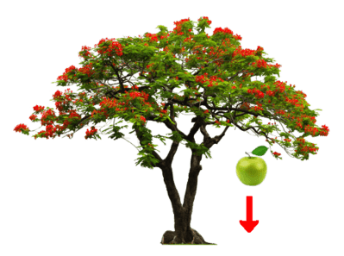
If an object is in contact with another, there will always be a normal force.
For example, what forces are acting on an apple as it falls from a tree towards the ground?
The answer is the force of gravity, pulling it down and drag, which acts upwards, slowing the movement.

Slide 6
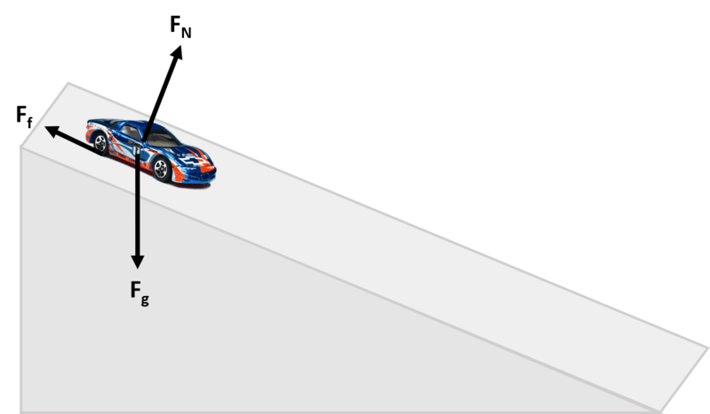
What forces act on a toy car as it rolls down a ramp?
Firstly, all objects have weight (F_{g}​) pulling down towards the Earth's centre.
A moving object has friction (F_{f​}) in the opposite direction to motion.
Any object on a surface has a normal (F_{N}​) acting at 90∘ to the surface.

Slide 7

Forces are invisible, so we can't see them. We can only feel their effects.
We can represent a force acting on an object by drawing an arrow, like the one below.
We call this a vector.

Slide 8

The vector shows us the direction and size of the force.
The vector points in the same direction that the force is applied in.
The length of the arrow tells us how large the force is. The longer the arrow, the bigger the force.

Slide 9
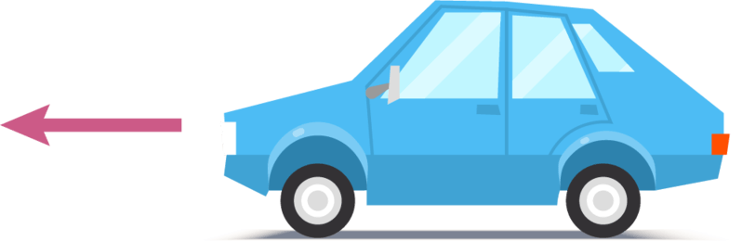
For example, the arrow below shows the force acting on a car.
We can see that this force is pushing the car forwards. This force comes from the engine of the car, and acts by turning the wheels which pushes the car forward.

Slide 10
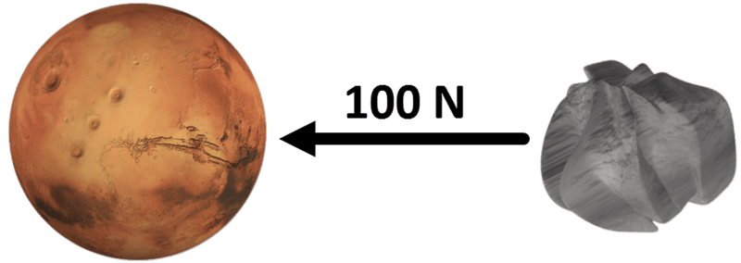
Like any force, the gravitational force acting on an object can be drawn as a vector.
A vector is an arrow pointing in the direction the force acts. Its length gives the magnitude of the force in Newtons (N).
For example, suppose the planet Mars pulls on an asteroid with a force of 100 N. The gravitational force felt by the asteroid can be represented as a vector that points back toward Mars. It has a length of 100 units representing 100 N.
According to Newton's Third Law, forces always occur in equal and opposite pairs. Therefore the asteroid must be pulling back on Mars, also with a force of 100 N.

Slide 11
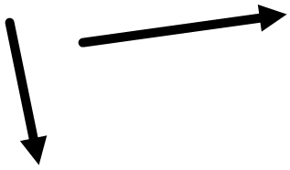
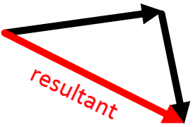
Adding vectors.
Many problems in Physics require one vector to be added to another vector. How is it done?
Consider these vectors, shown in black. Say we want to add them together. To do that, take one of the vectors and place its tip (the arrowhead) against the tail of the other vector.
Now draw a new vector that goes from the tail of the first vector to the tip of the second one. This one is called the resultant and it's shown here in red. If you are asked to find a "resultant velocity" or a "net force," this is what you do. Always add vectors tip to tail!

Slide 12
